Slide 1

Video Game Sales Analysis
By: Sean Bunk

Slide 2
Below is a link to the data set from Kaggle , as well as a link to my GitHub repository so you can see how I cleaned, explored, and analyzed the data using Python.
Kaggle: https://www.kaggle.com/datasets/gregorut/videogamesales
GitHub:
https://github.com/seanbunk/Video_Game_Analysis.git

Slide 3
Hypothesis
After briefly looking at the data, I predict that Super Mario Bros released in 1985 would be the most popular game sold. I also think that the PS4 would be the most popular system sold worldwide. The gaming industry really hit its peak in the early 2000s. And out of the 3 regions listed, I believe that Japan will have had the most game sales. I think that Adventure games would be the most popular worldwide.

Slide 4
Which gaming system had the highest Global Sales?
Global_Sales
Platform
PS2 | 1233.46
X360 | 969.60
PS3 | 949.35
Wii | 909.81
DS | 818.91
PS2 has the highest total Global Sales out of any of the 31 gaming systems in the data set.

Slide 5
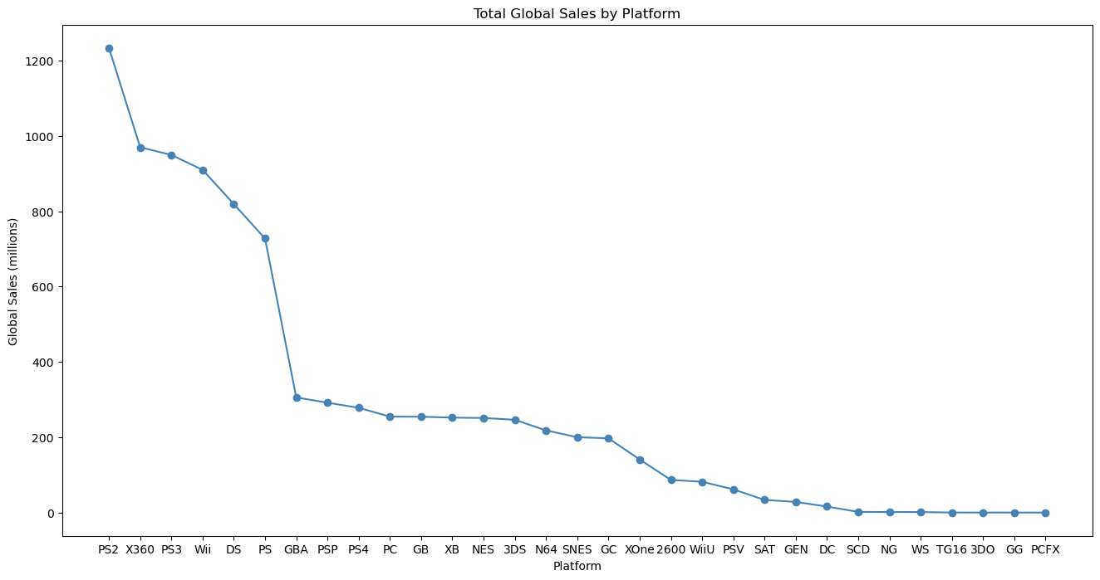
The Xbox 360 and the PS3 had a significantly large gap
from the PS2

Slide 6
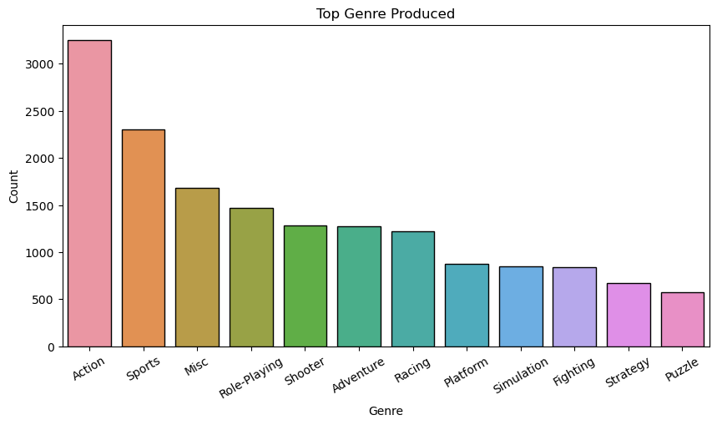
What was the Top Genre of Game Produced?
As we can see above a bar chart shows
us that the Action Genre produced
more games than any other Genre.

Slide 7
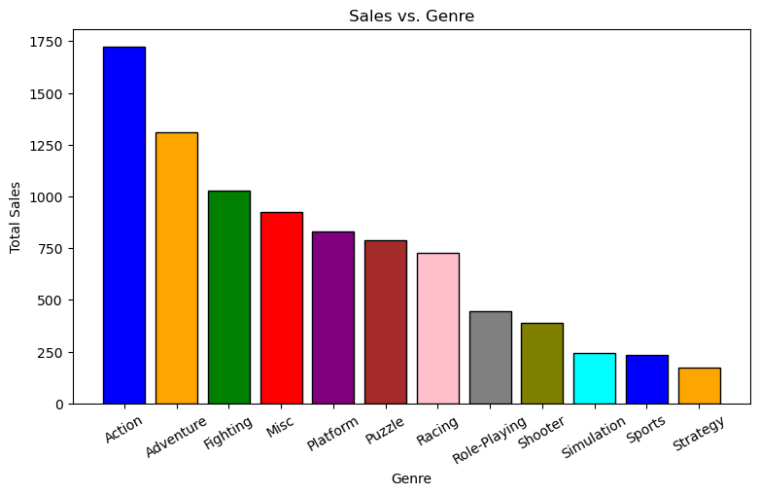
Which Genre had the most Sales?
Not only were the Action Genre of games
the most produced, but they are also the
genre with the most sales Globally.

Slide 8
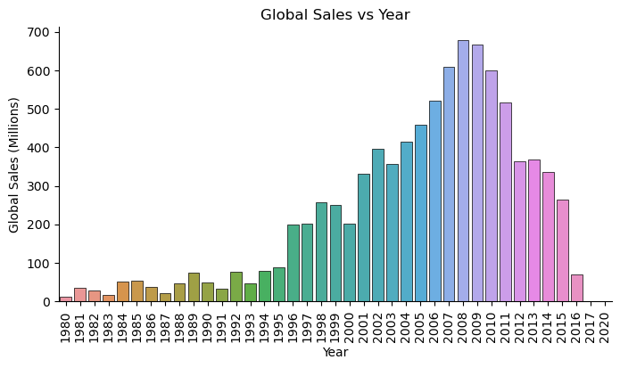
Which year between 1980 and 2020, have sold the most video games?
2008 had the highest sales out
of all the years at almost 700 million
It also look like gaming sales didn’t start
to rise until about 1996 and have been swiftly
rising until about 2012, where it starts
to taper down.

Slide 9
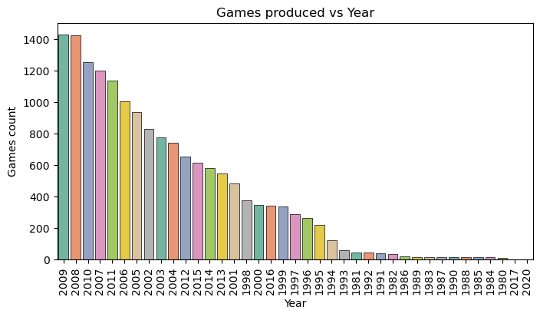
The graph below shows us the number of games produced by the year.
2009 seem to have the most games produced followed by a close 2nd at
2008.

Slide 10
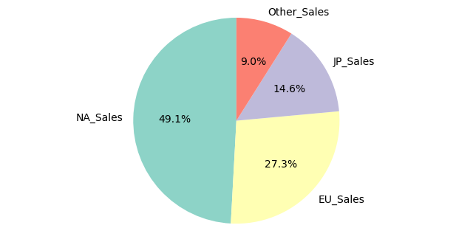
North America? Europe? Japan?
The data set has provided me with three different regions, North America, Europe, and Japan. I was
surprised to see that North America has made the most video game sales.

Slide 11
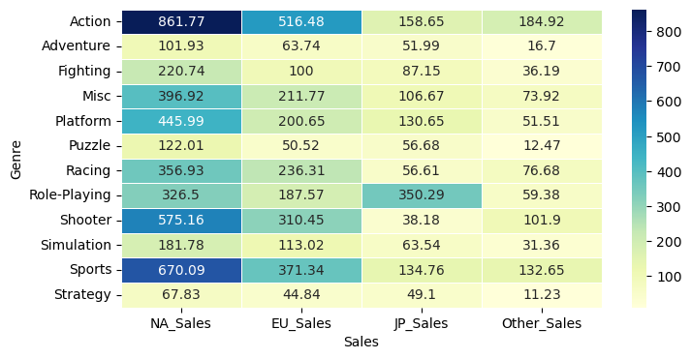
North America has the highest sales compared to the other regions.
Both Europe and North America have action games as the most popular genre.
Japan has role playing games as the most popular genre.

Slide 12
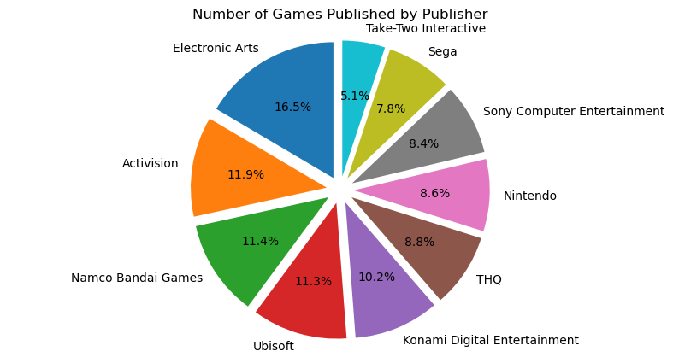

What are the Top Ten Video Game Publishers?
American company
Electronic Arts is the number
one game publisher Globally.
Second to that would be
Another American company
called Activision.

Slide 13
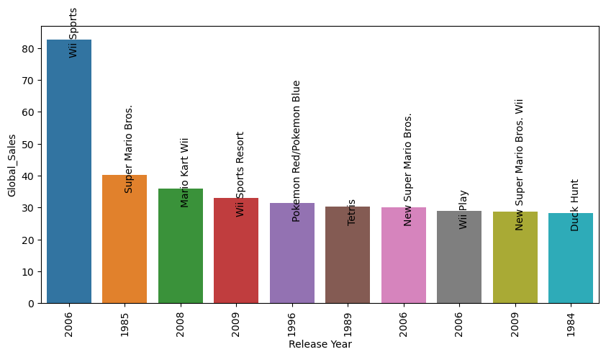
Which Video Game Produced the most Sales Globally?
2006’s release of Wii Sports
on the Nintendo Wii has the
most Global Sales out of any
video game.

Slide 14
Conclusion
After investigating I found that the PS2 gaming console had the highest global sales
out of any of the 31 gaming systems. I also found out that Action games were not only the most
produced type of game out of all the genres, but they also had the most sales globally. Between the
years 1980 and 2020, 2008 had the highest sales. The gaming sales didn’t seem to really boom until about
1996, peaking in 2008, and then starting to taper down around 2012. Which region had the most video
game sales? To my surprise is North America. In my hypothesis I was confident that Japan would take the
lead. Not only did North America have the most sales, but the top video game Publishers were also from
North America. Between the three regions action and sports genre were the most popular in both
North America and Europe, and Japan’s most popular genre is role playing games. The video game that
produced the most sales globally was 2006’s Wii Sports on Nintendo’s gaming system the Wii.

